Slide 1
Pointers & linked list
SaBra Neal
September 16,2016

Slide 2
Pointers
What is a pointer?
Variable who’s value is the address of another variable stored in that memory location
Declaring a pointer
We use (*) to declare a pointer
int*p //declares a pointer that points to an integer
char*h //declares a pointer that points to a char
int*p = NULL //setting pointer to NULL (no address value)
Storing an address value in a pointer
int v = 30; //integer value stored in variable v
int *p = &v //stores the address value of variable v
Access the value using the pointer
*p = 30 //dereference the pointer to access the value stored using *

Slide 3
Struct
Structs are structures that gives the programmer the ability to define a type of variable that holds several member values
//declares a struct called student
typedef struct studentType*student
//defines type student
struct studentType{
int id; //integer id member value
char*name; //string name member value
double gpa; //double gpa member value
};

Slide 4
Memory Allocation
Memory allocation is necessary to set aside memory for the variables that created within your program.
student* s = (student*) malloc(1*sizeof(struct studentType));
s->id = 15;
s->name = “SaBra”;
s->gpa = 4.0;

Slide 5
De-allocate Memory
To release memory discarded, we must release it.
Use free() function to release memory
int *p;
//release the memory stored in p with free function
free(p);

Slide 6
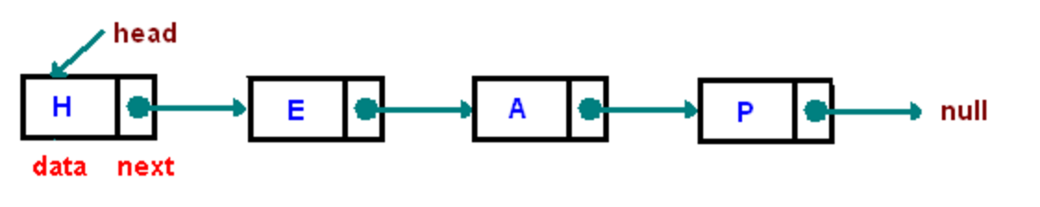
Linked List
A linear data structure where each element is an object
Each element encompasses data value and a pointer to the next element
The entry point of the list is called the head
The head is the reference to first element in the list
We denote the end of the list by the pointer to the next element in the last element of the list is NULL
Reference: https://www.cs.cmu.edu/~adamchik/15-121/lectures/Linked%20Lists/linked%20lists.html
Notes:
https://www.cs.cmu.edu/~adamchik/15-121/lectures/Linked%20Lists/linked%20lists.html

Slide 7
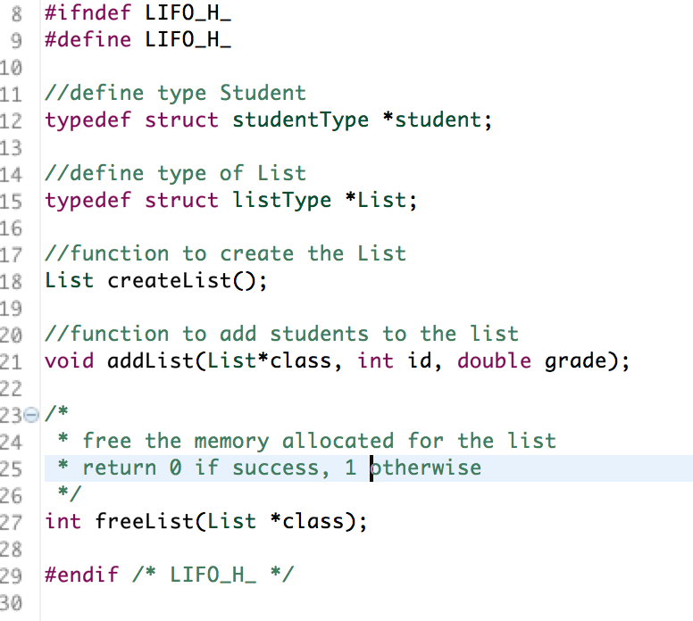
H Files
Contains function declarations and macro definitions to be shared between several file

